Slide 1


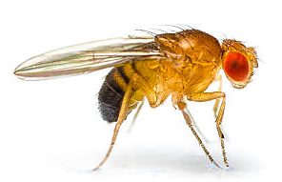
Desynchrony — Bug or Feature?
Atharv Suryawanshi & Stella Vielhaber
Neurophysiology and Biophysics

Slide 2
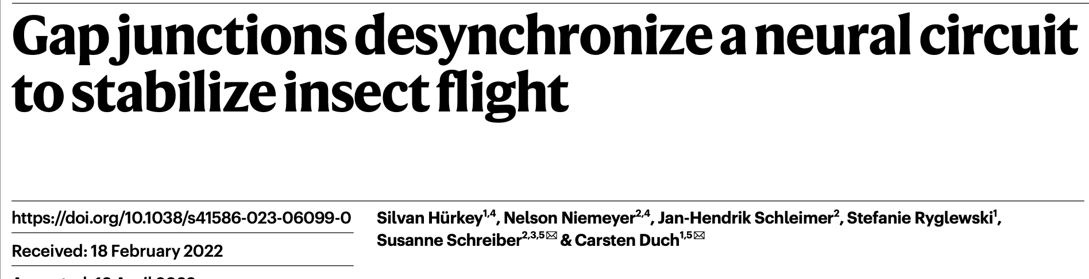

Slide 3
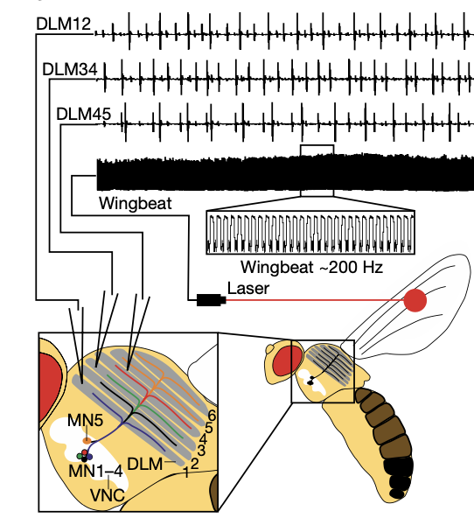
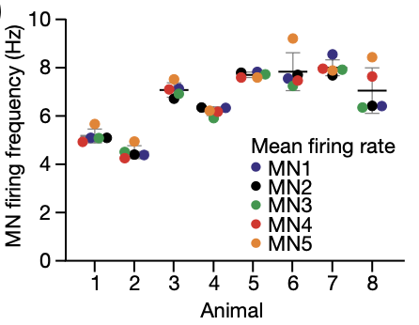
Five motor neurons coordinate a 200 Hz wingbeat
How can a few motor neurons maintain stable high-frequency power output??

Slide 4
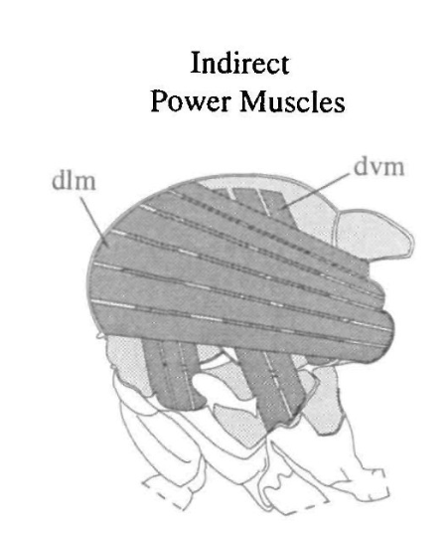
Thoracic oscillation is mechanical, not neural
Stretch activation: stretching a fibre transiently increases its active force output
Ventral muscle fiber contracts → thorax deforms → dorsal muscle fiber stretches → next contraction
Mechanical feedback creates self-sustaining oscillations
5
6
4
3
2
1
Dickinson et al. The Control of Mechanical Power in Insect Flight, 1998

Slide 5
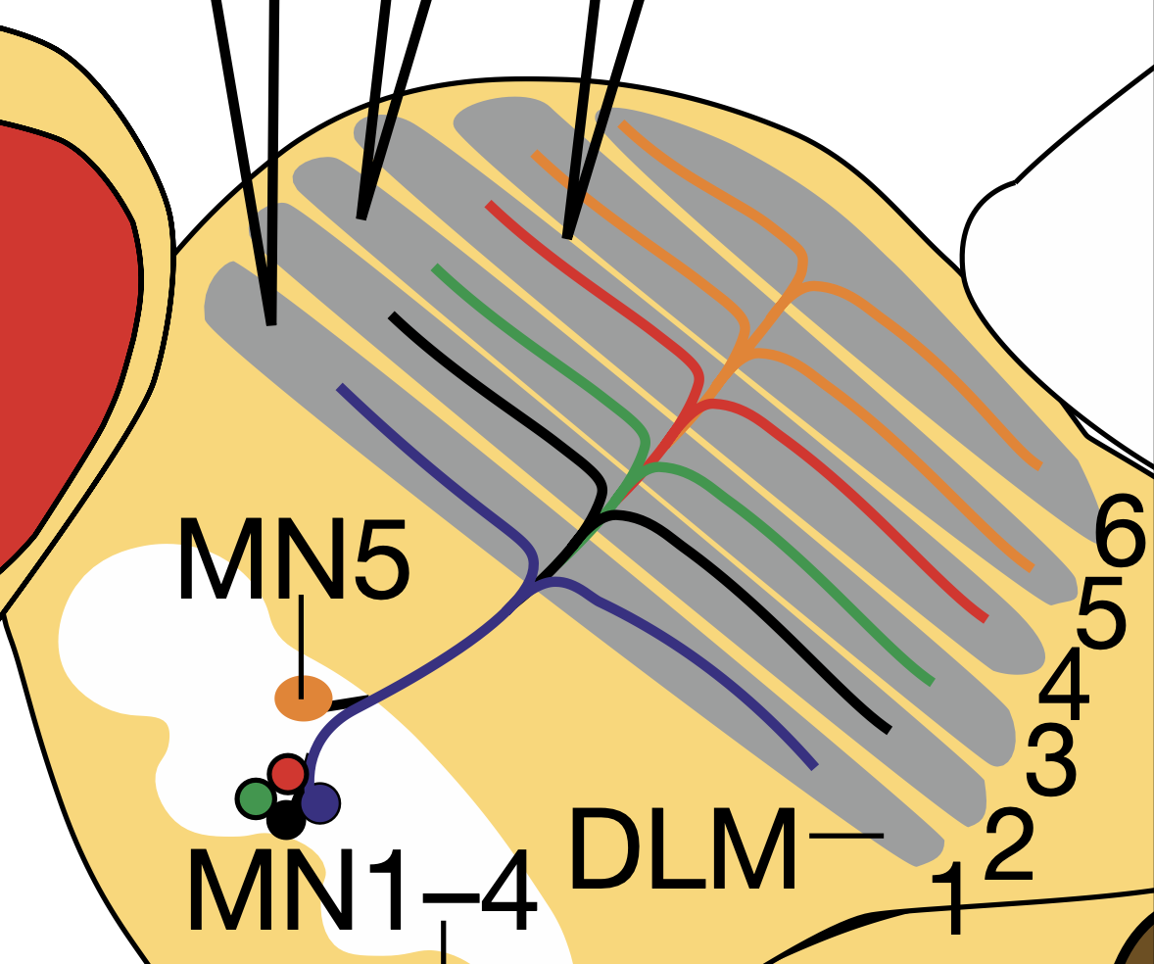
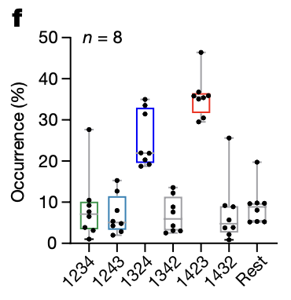
Motorneuron phase coordination
Splay state: stable, repeating sequence of neuron firing with fixed phase relations
→ In Drosophila DLM, preferred sequences are 1-4-2-3 or 1-3-2-4

Slide 6
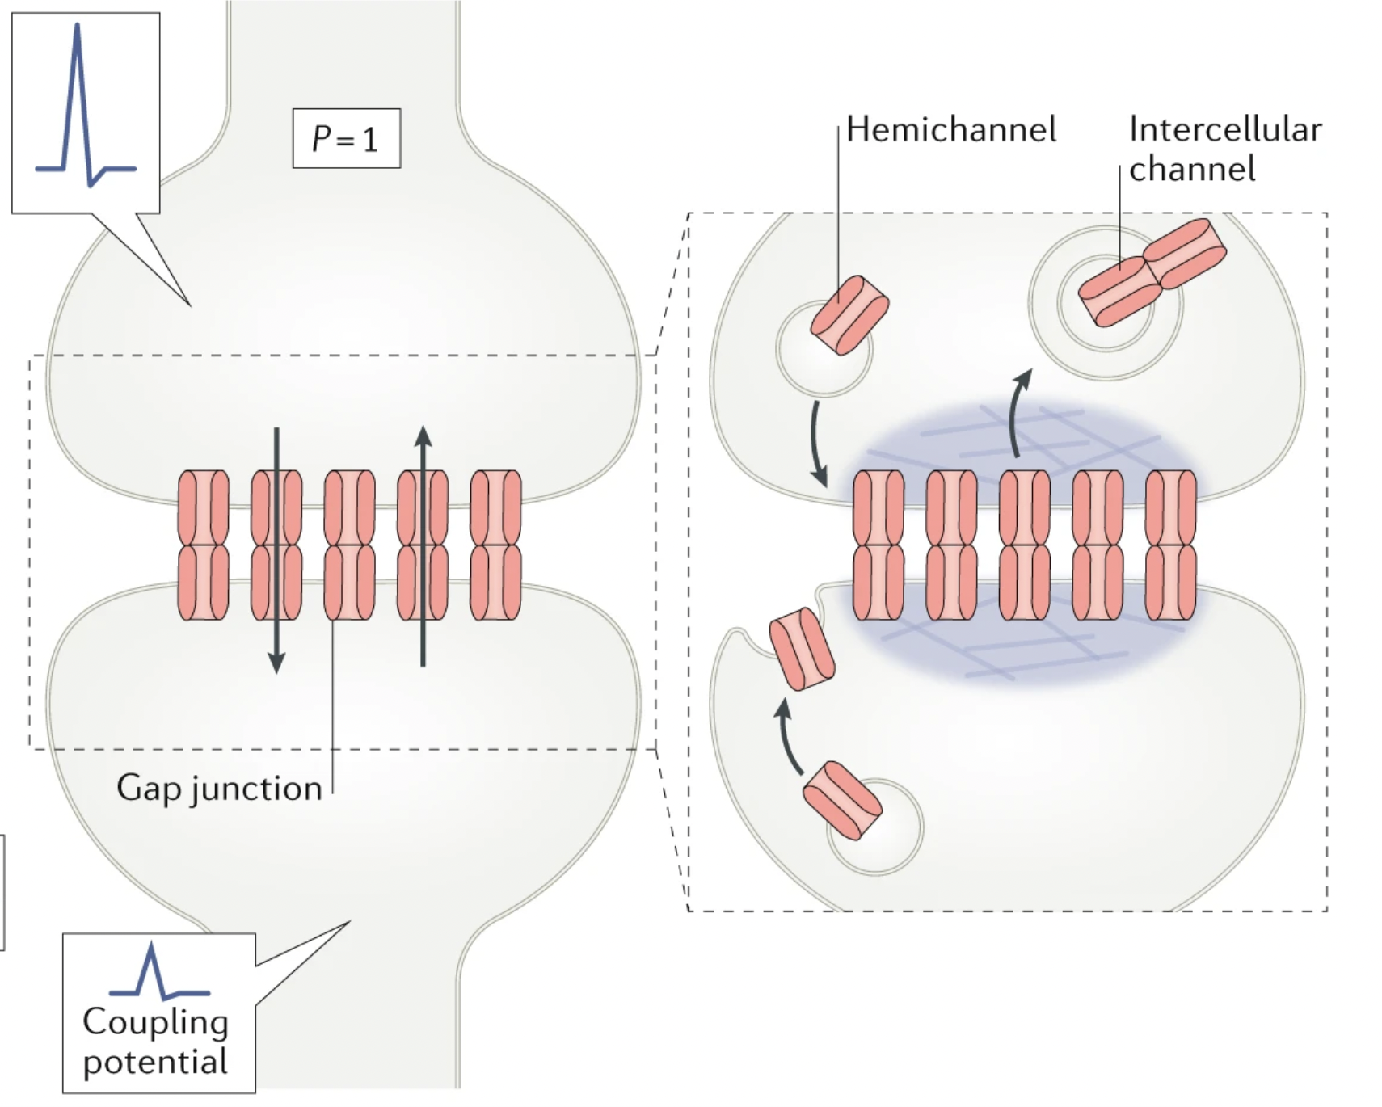
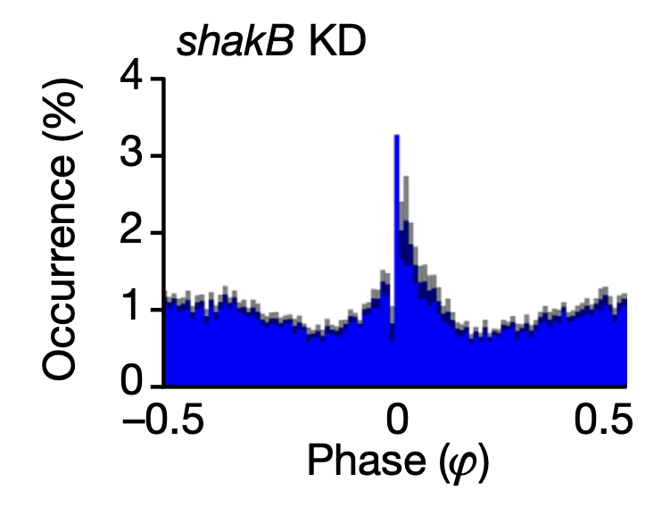
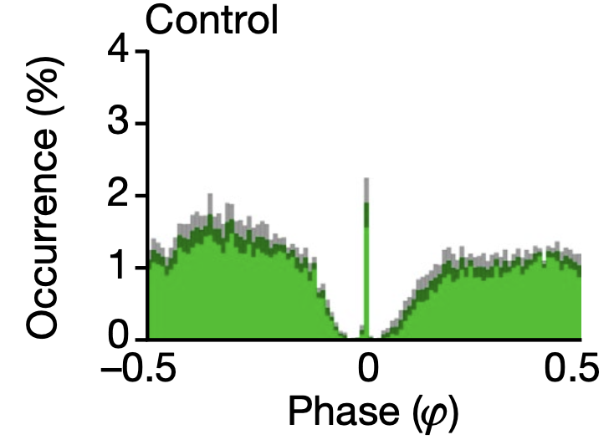
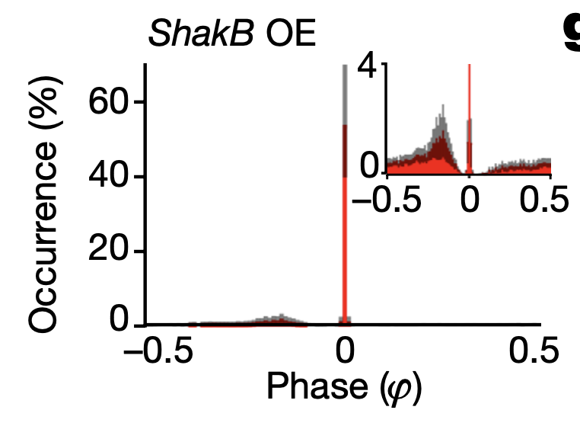
Motor neurons modulate power via weak electrical coupling
Primary connection between motor neurons is via gap junctions formed by innexin shakB
Weak coupling desynchronizes activity into phase locked splay states
Knockdown collapses phase lock into randomness
Overexpression pushes everything into perfect synchrony
Alcamí & Pereda. Beyond plasticity: the dynamic impact of electrical synapses on neural circuits, 2019

Slide 7
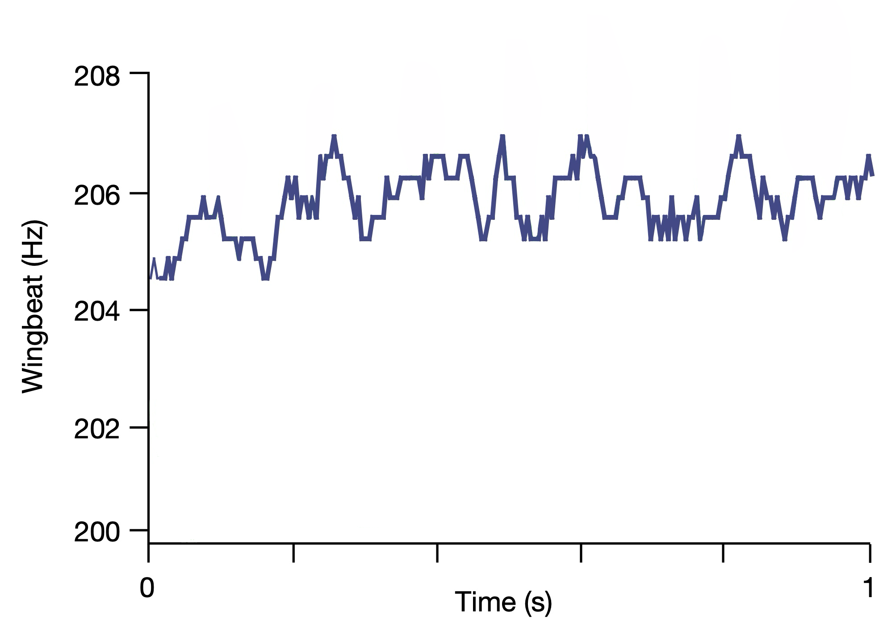
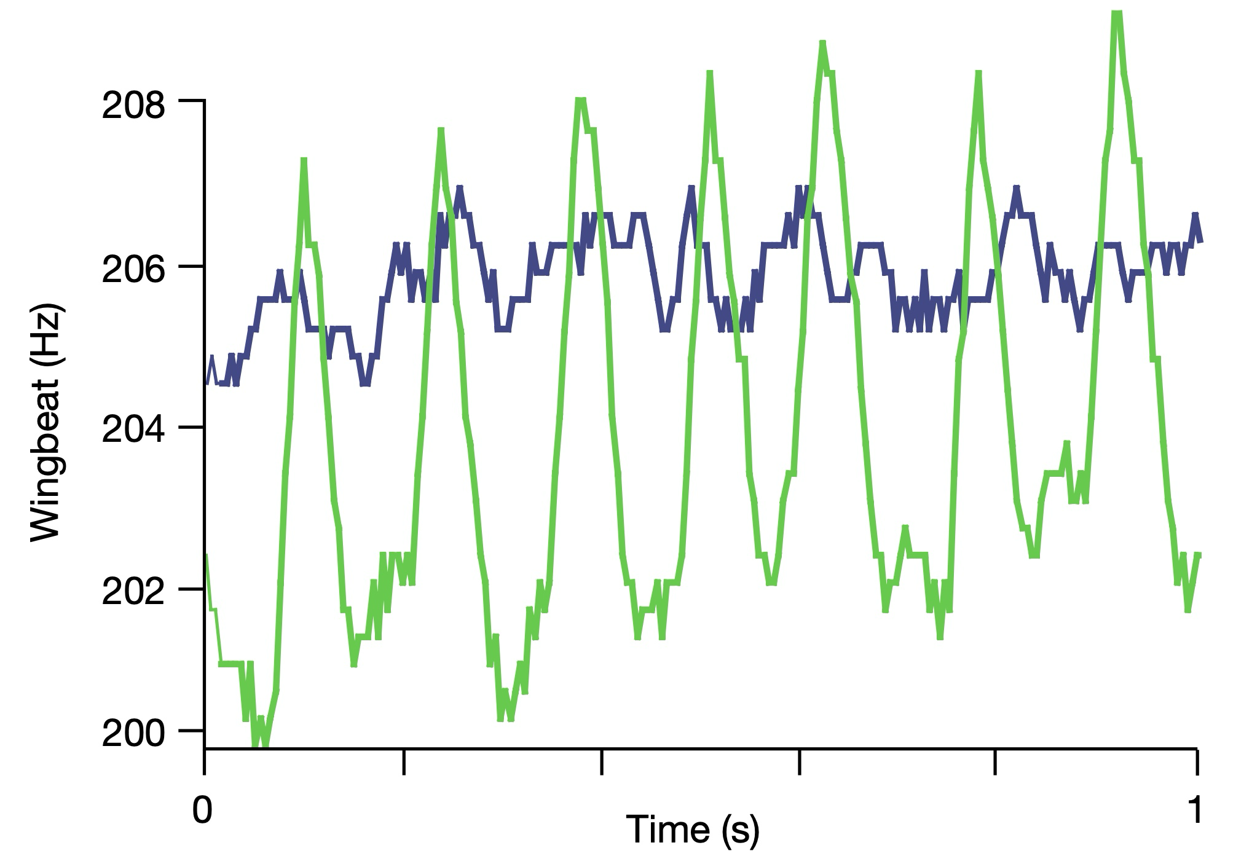
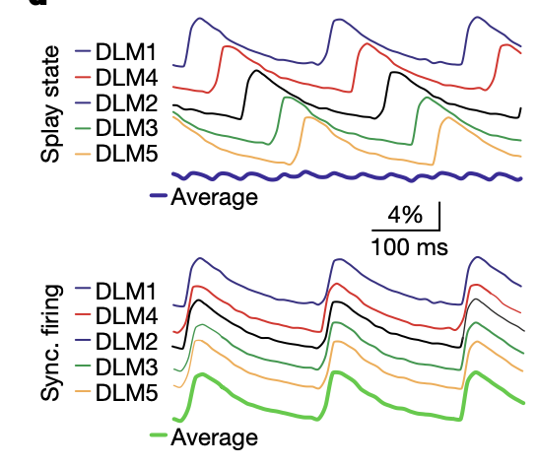
Splay states distribute muscle activation smoothly → stable flight

Slide 8
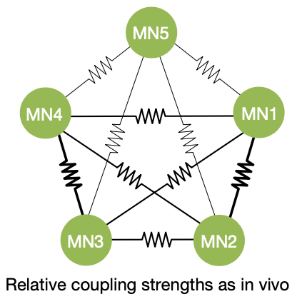
Network model

Slide 9
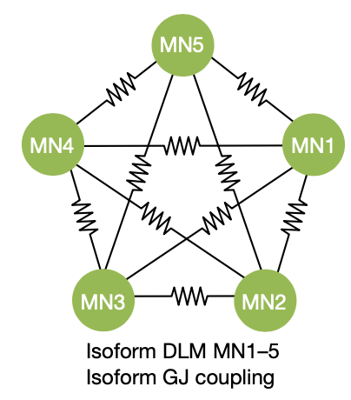
Network models:
Coupling coefficient:
postsynaptic charge / presynaptic charge
0.005
0.005
0.003
0.003
0.005
0.005
0.01
0.01
0.005
0.004
homogeneous coupling
heterogeneous coupling

Slide 10
Model Validation

Slide 11
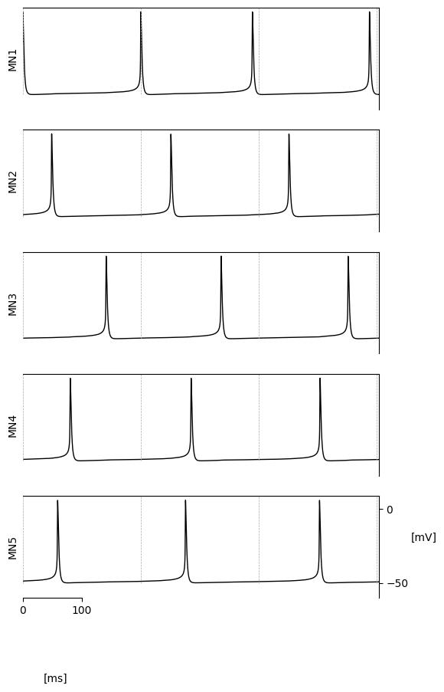
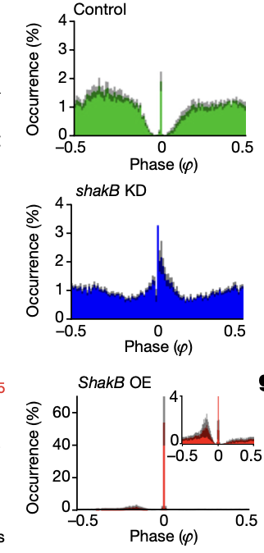
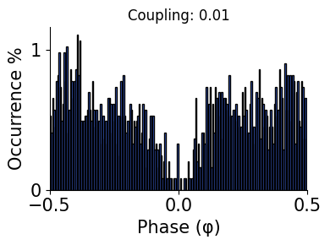
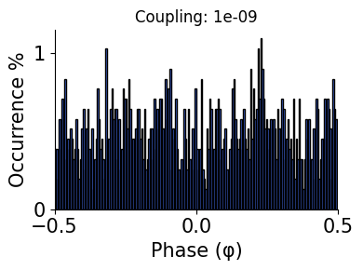
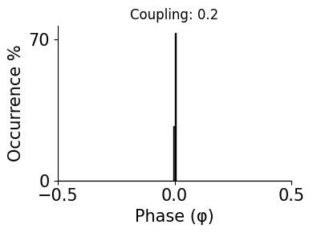
Changing coupling strength reproduces shakB phenotypes
Alcamí & Pereda. Beyond plasticity: the dynamic impact of electrical synapses on neural circuits, 2019
Phase lock
Randomness
Synchrony

Slide 12
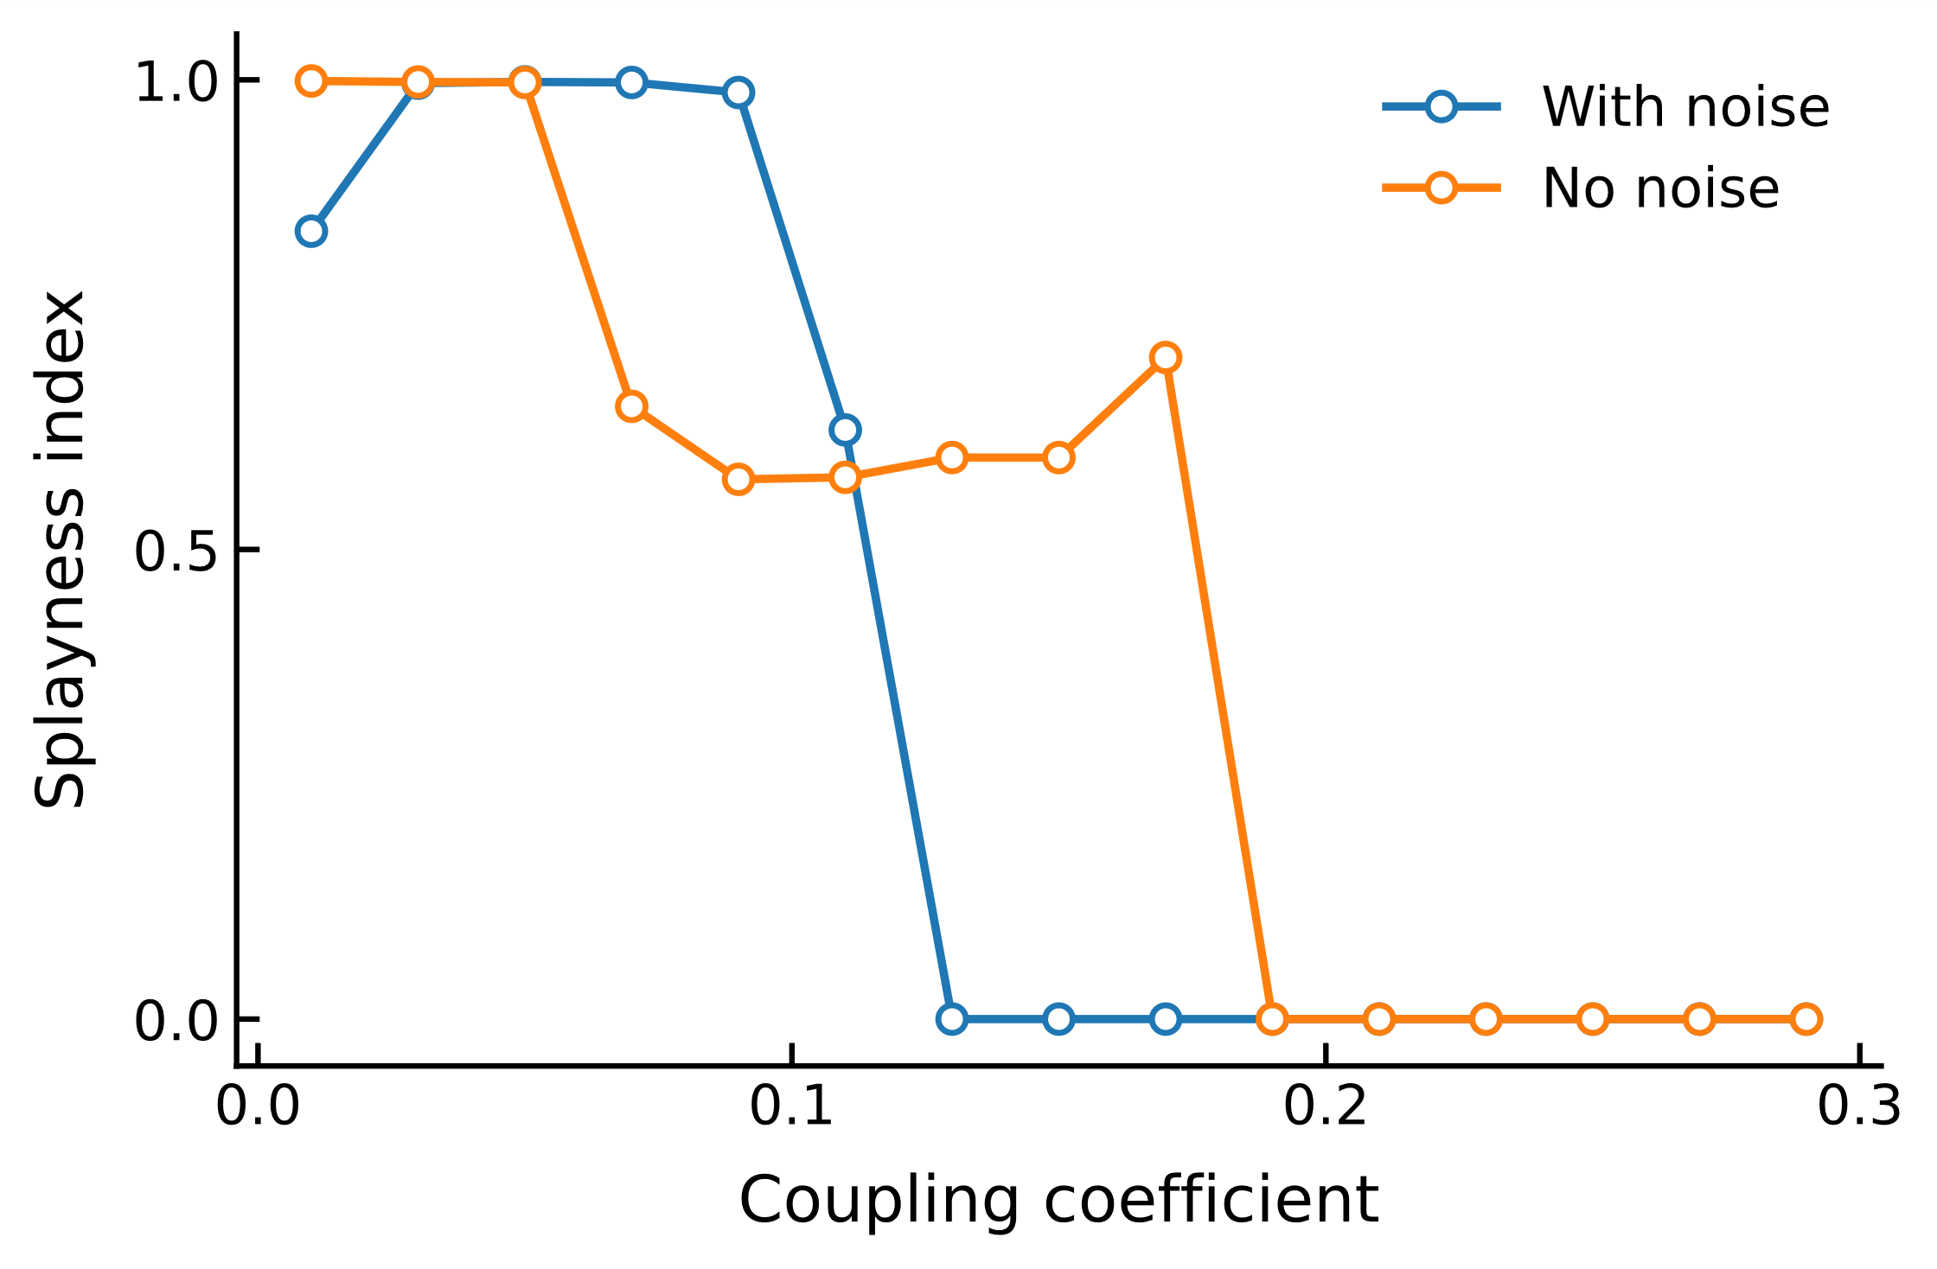
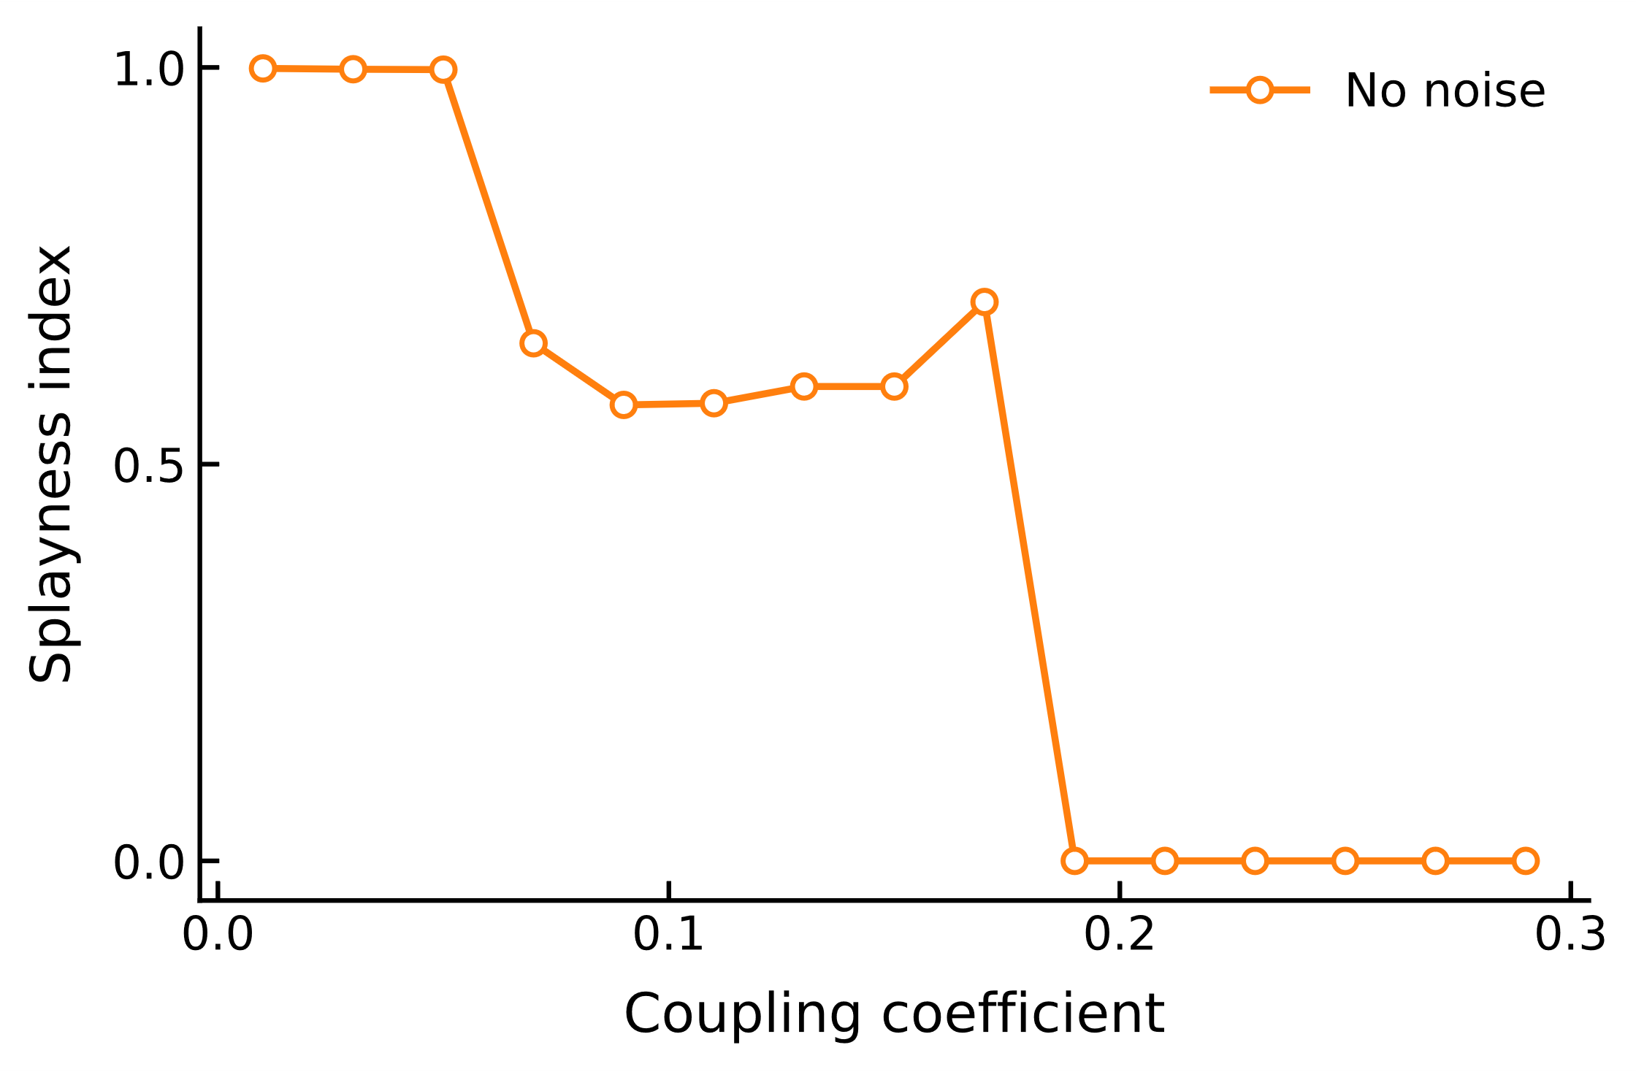
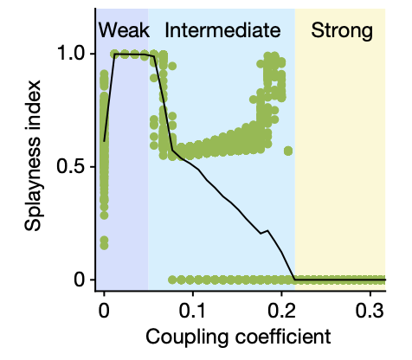
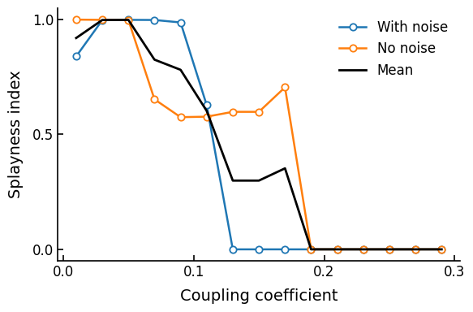
Splayness peaks at intermediate coupling strength
Splayness: measure of spread across all spikes (0 = sync., 1 = evenly distributed)

Slide 13
Extending the Model

Slide 14
Can we predict which splay states are more stable, by looking at the coupling coefficients?
0.003
0.003
0.01
0.01
0.004
→ Unstable: 1234 & 1243
→ Stable: 1324 & 1423

Slide 15
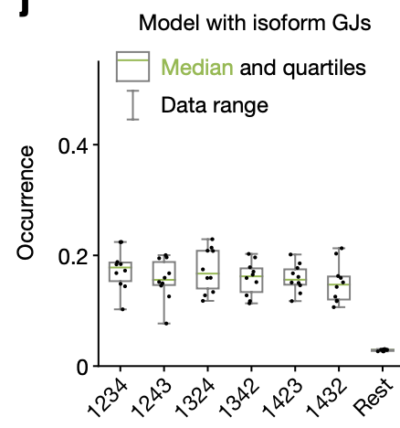
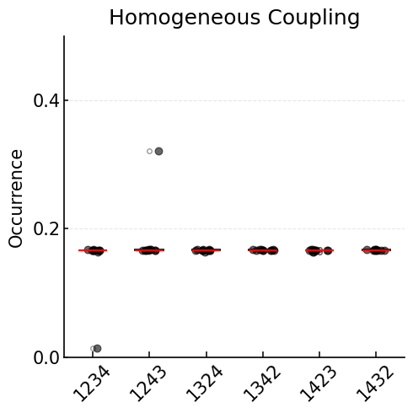
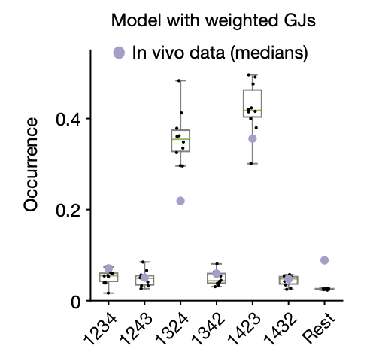
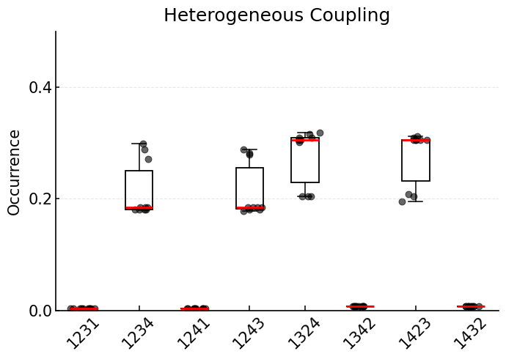
Stability of splay states

Slide 16
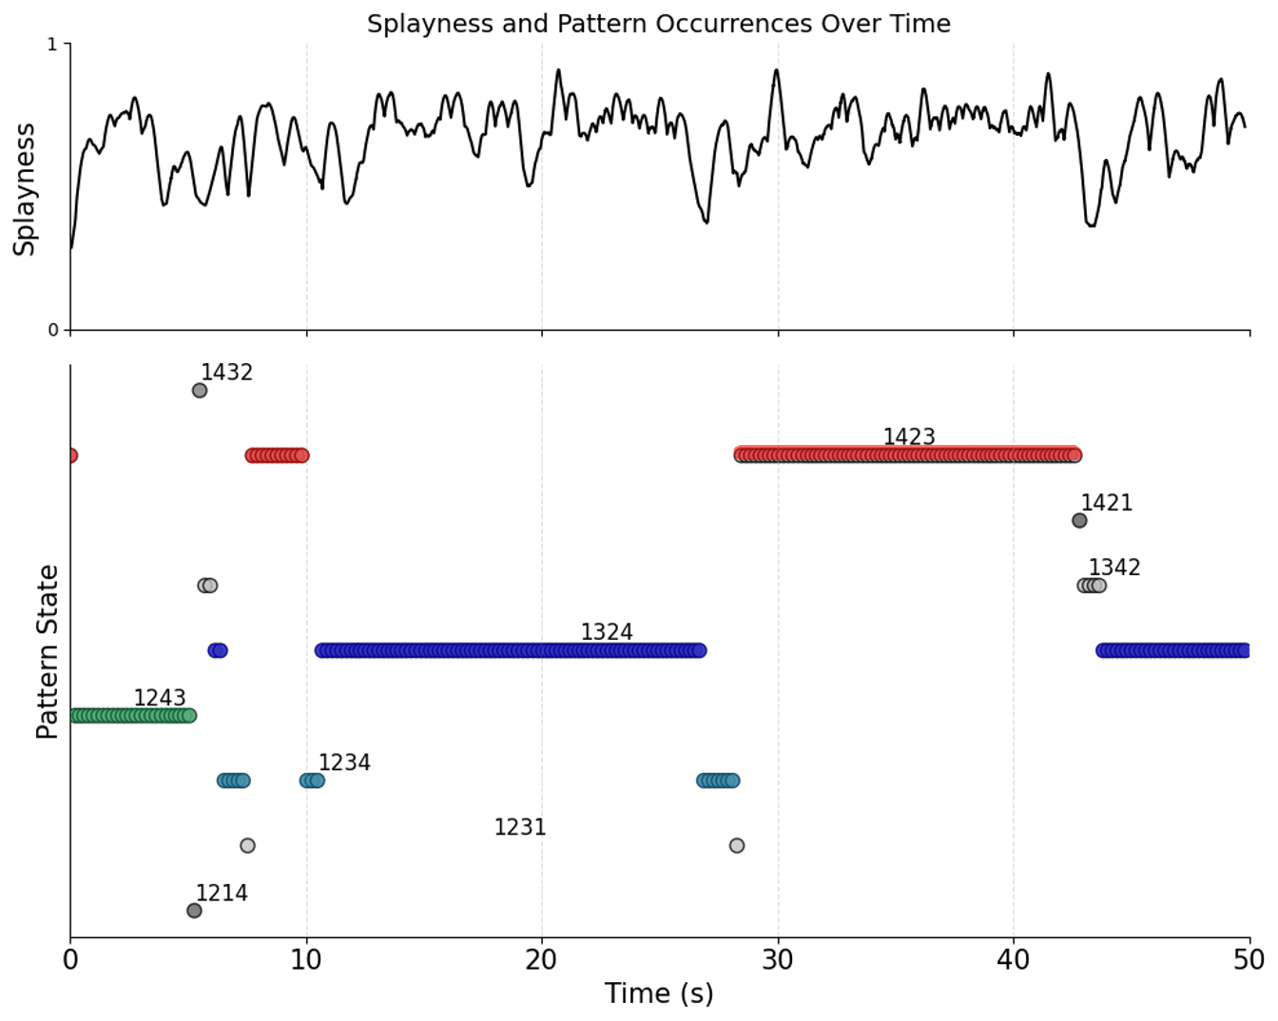
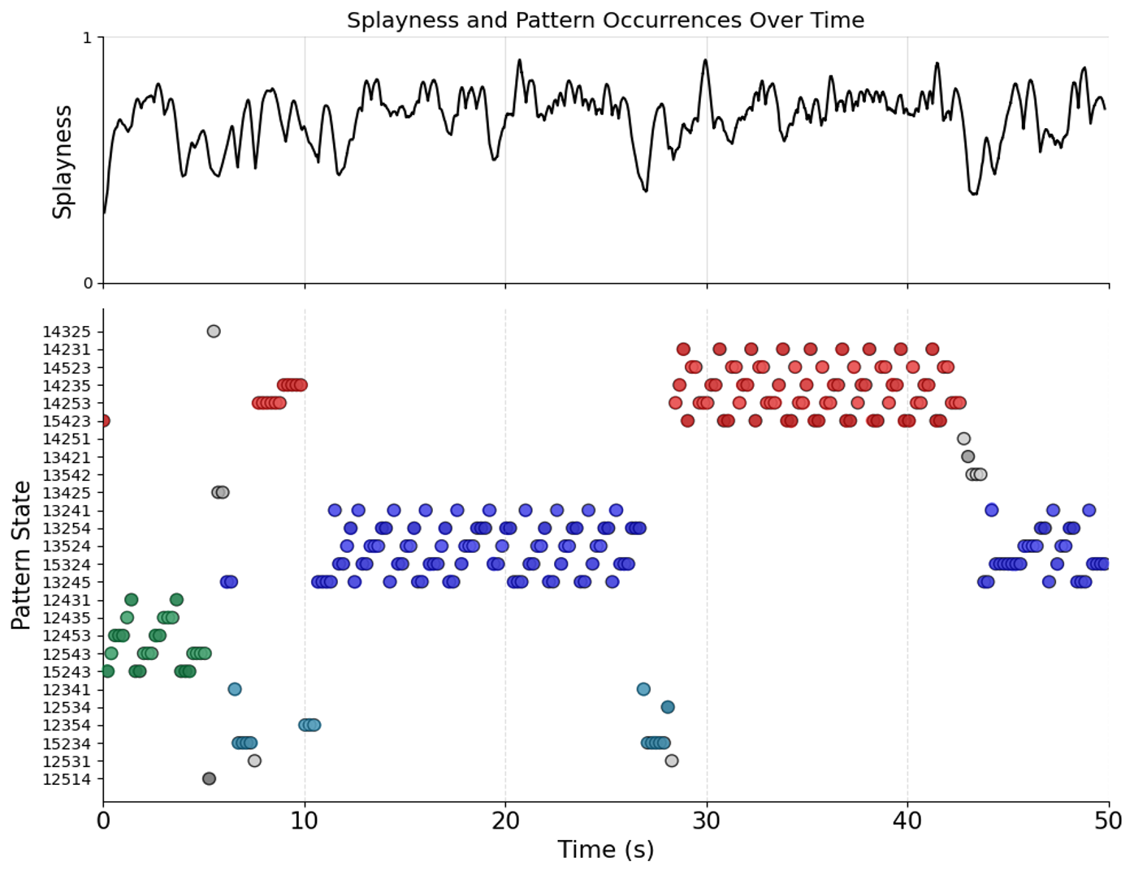

Slide 17
Conclusion
Coupling strength changes the splayness
Stable splay states are more likely to occur
Stability of splay states can be predicted by their coupling strengths
Desynchronization — is it a bug or a feature?
→ it’s a feature!

Slide 18
Sources
Figures:
Alcamí, P., Pereda, A.E. Beyond plasticity: the dynamic impact of electrical synapses on neural circuits. Nat Rev Neurosci 20, 253–271 (2019).
Dickinson, M. H., Lehmann, F. , Chan, W. P. The Control of Mechanical Power in Insect Flight, American Zoologist, Volume 38, Issue 4, September 1998, Pages 718–728.
https://stablediffusionweb.com/de/image/22747144-fruit-fly-swarm-on-white-background
Literature:
Dickinson, M. H., Lehmann, F. , Chan, W. P. The Control of Mechanical Power in Insect Flight, American Zoologist, Volume 38, Issue 4, September 1998, Pages 718–728.
Hürkey, S., Niemeyer, N., Schleimer, J. H., Ryglewski, S., Schreiber, S., & Duch, C. (2023). Gap junctions desynchronize a neural circuit to stabilize insect flight. Nature, 618(7963), 118-125.
Pringle, J. W. S. (1949). The excitation and contraction of the flight muscles of insects. The Journal of physiology, 108(2), 226.
Sun, Yi-An; Wyman, Robert J. (1997). Neurons of the Drosophila giant fiber system: I. Dorsal longitudinal motor neurons. The Journal of Comparative Neurology, 387(1), 157–166.

Slide 19

Questions?

